Slide 1
EMPLOYEE MANAGEMENT SYSTEM WITH BIOMETRIC ATTENDANCE
PRESENTED BY:
Divya Kashyap (2315035)
Rahul Rana (2315029)
Sahil Aggrawal (2315035)
Ullas Sood (2315049)

Slide 2
What is Employee Management System?
Employee Management System is a versatile application, developed to maintain the details of employees working in any organization.
The objective of the system is to provide a comprehensive approach towards the management of employee information.
An Employee Management System consists of crucial work-related and important personal information about an employee.
A good employee management system can actually make a world of difference to an organization, especially true in case of start-ups and small businesses, where the focus should be on growing the business more than anything else.

Slide 3
Objectives of our project
Design of a standalone Employee management system to fulfil requirements such as keeping record of employees working in organization, recording salary details, managing leaves taken by employees and attendance of employees.
Well-designed database to store employee information.
A user friendly front-end for the user to interact with the system.
Easy and secure marking of attendance using biometric approach.
Generic System that can be easily modified to meet any organizations need.
Easy and fast marking of attendance using biometric sensor.

Slide 4
Existing System
The records are maintained in registers
Time consuming process.
Complicated searching, editing and updates.
Slow and inefficient marking of attendance.

Slide 5
Proposed System
Helps in maintaining the computerized employee details.
Easy attendance marking using biometric sensor.
Easy application and accepting/rejecting of leave requests.
Generic system that can be modified according to any organizations need in minimum time.
Inserting and Editing of employee details is simplified and computerized allowing admins to work with system accordingly.

Slide 6
Software Design

Slide 7
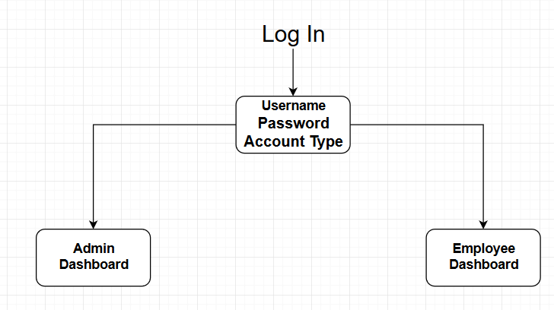

Slide 8
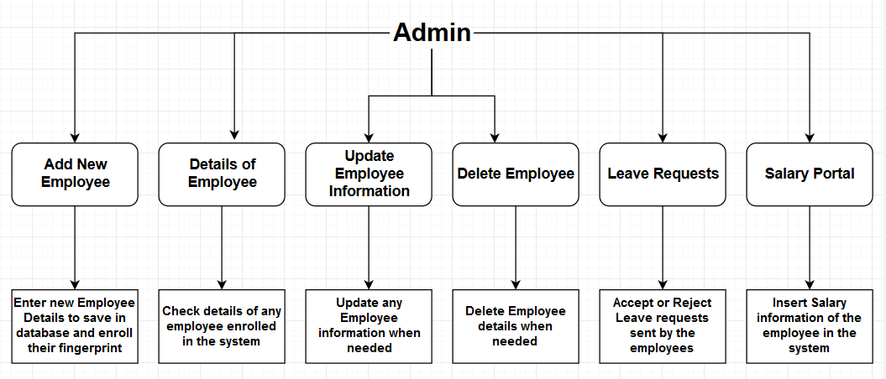

Slide 9
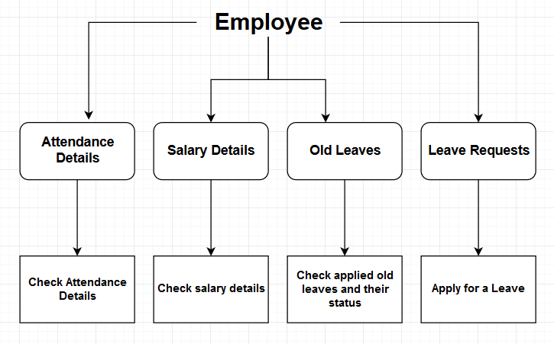

Slide 10
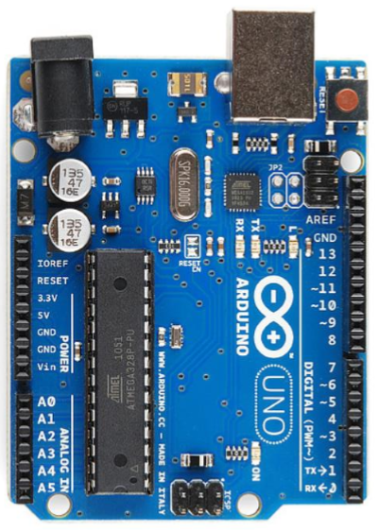
Hardware Modules
Arduino Uno r3
The Arduino Uno is a microcontroller board based on the ATmega328. It has 20 digital input/output pins (of which 6 can be used as PWM outputs and 6 can be used as analog inputs), a 16 MHz resonator, a USB connection, a power jack, an in-circuit system programming (ICSP) header, and a reset button. It contains everything needed to support the microcontroller; simply connect it to a computer (or appropriate wall power adapter) with a USB cable or power it with a AC-to-DC adapter or battery to get started.

Slide 11
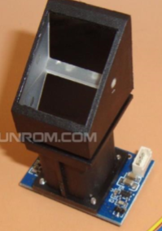
Hardware Modules
Fingerprint Sensor r305
Finger print sensor module with TTL UART interface for direct connections to microcontroller UART or to PC through MAX232 / USB-Serial adapter. The user can store the finger print data in the module and can configure it in 1:1 or 1: N mode for identifying the person. The FP module can directly interface with 3v3 or 5v Microcontroller. A level converter (like MAX232) is required for interfacing with PC serial port.

Slide 12

Login / Welcome Screen

Slide 13
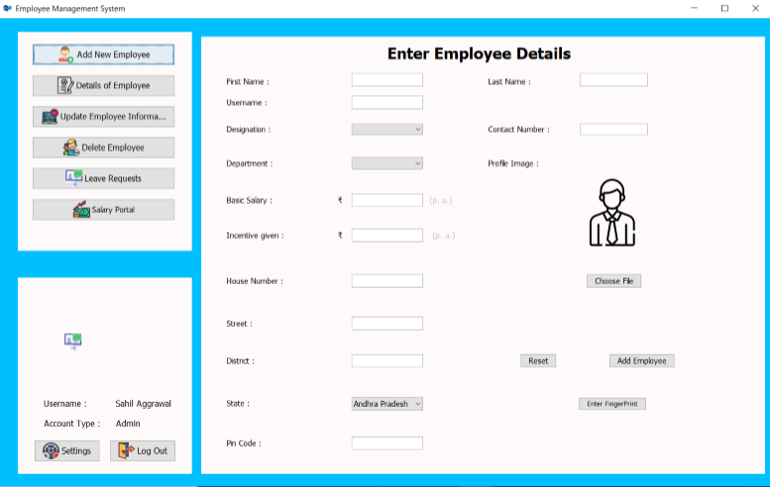
Employee Record Entry Form

Slide 14
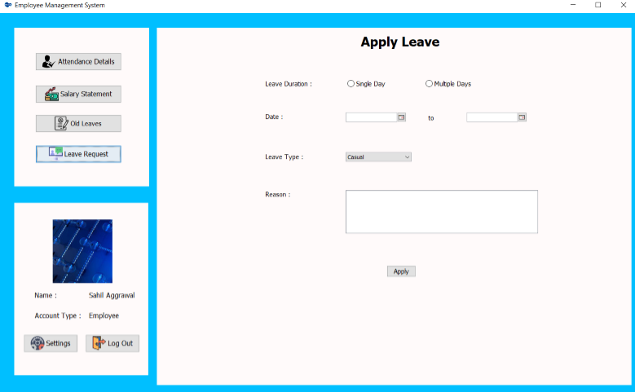
Employee Leave Request Form

Slide 15
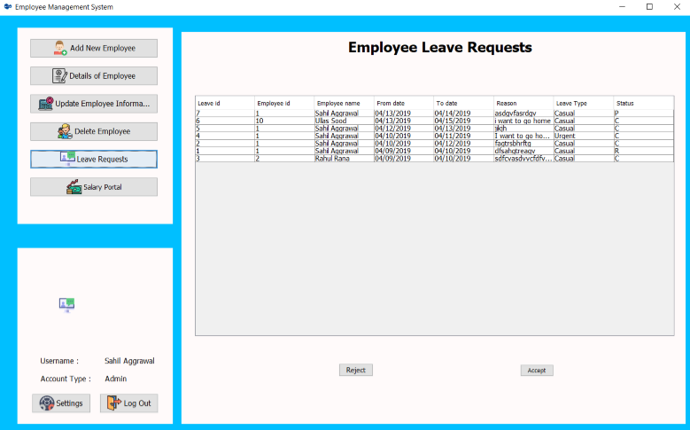
Admin Leave Request Accept/Reject Portal

Slide 16
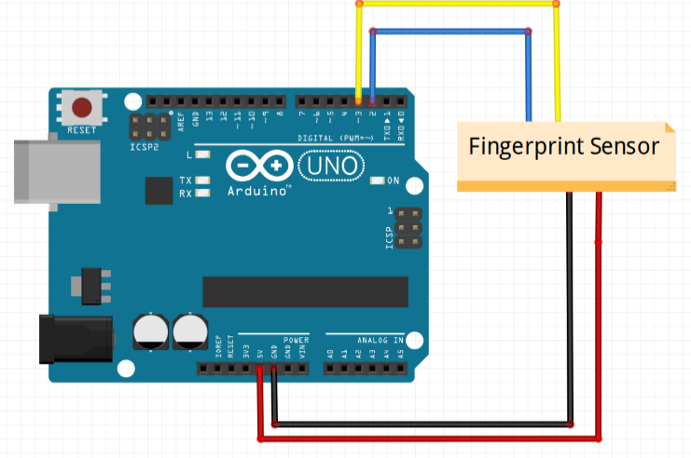
Finger Print Module Interfacing

Slide 17
System Requirements
Software Requirements
JRE (Java Runtime Environment)
Hardware Requirements
Processor : Pentium 2 266MHz or higher
RAM : 128MB or more
Hard Disk : 128MB or more
Arduino Uno r3
Finger print module r305

Slide 18
Advantages
Provide computerized system for maintaining records.
More efficient & reliable.
Less time consuming and easy to use.
Huge data storage with less computer memory.
Avoid Human errors & efforts for Maintaining daily data.
Avoid Data manipulations.
Also avoids Data inconsistency & redundancy.

Slide 19
Limitations
This software will run on a single pc
Admin and Employee have to sit on the same pc
No network Connection
Generic system

Slide 20
Live Demonstration

Slide 21
Thank You !

